Slide 1
Regular Expressions and Lexical Analysis
Chapter 3
Unit 2

Slide 2
Review: Compiler Phases:
Source program
Lexical analyzer
Front End
Syntax analyzer
Symbol table
manager
Semantic analyzer
Error handler
Intermediate code generator
Code optimizer
Backend
Code generator

Slide 3
Outline
Role of lexical analyzer
Specification of tokens
Recognition of tokens
Lexical analyzer generator
Finite automata
Design of lexical analyzer generator

Slide 4
The Role of the Lexical Analyzer
(Interaction of Lexical analyzer with parser)
Token
To semantic
analysis
Source Program
Lexical Analyzer
Parser
getNextToken
error
error
Symbol Table

Slide 5
Lexical Analyzer
Functions(Tasks)
Grouping input characters into tokens
Stripping out comments and white spaces
Keep track of number of newline characters seen
Correlating error messages with the source program
Handle include files and macros

Slide 6
The Reason for Using the Lexical Analyzer
Simplifies the design of the compiler
A parser that had to deal with comments and white space as syntactic units would be more complex.
If lexical analysis is not separated from parser, then LL(1) or LR(1) parsing with 1 token lookahead would not be possible (multiple characters/tokens to match)
Compiler efficiency is improved
Systematic techniques to implement lexical analyzers by hand or automatically from specifications
Stream buffering methods to scan input
Compiler portability is enhanced
Input-device-specific peculiarities can be restricted to the lexical analyzer.

Slide 7
Why to separate Lexical analysis and parsing
Simplicity of design
Improving compiler efficiency
Enhancing compiler portability (e.g. Linux to Win)

Slide 8
Lexical Analyzer
Lexical analyzer are divided into a cascade of two process.
Scanning
Consists of the simple processes that do not require tokenization of the input.
Deletion of comments.
Compaction of consecutive whitespace characters into one.
Lexical analysis
The scanner produces the sequence of tokens as output.

Slide 9
Lexical Analysis
What do we want to do? Example:
if (i == j)
Z = 0;
else
Z = 1;
The input is just a string of characters:
\t if (i == j) \n \t \t z = 0;\n \t else \n \t \t z = 1;
Goal: Partition input string into substrings
Where the substrings are tokens

Slide 10
What’s a Token?
A syntactic category
In English:
noun, verb, adjective, …
In a programming language:
Identifier, Integer, Keyword, Whitespace,

Slide 11
Tokens
Tokens correspond to sets of strings.
Identifier: strings of letters or digits, starting with a letter
Integer: a non-empty string of digits
Keyword: “else” or “if” or “begin” or …
Whitespace: a non-empty sequence of blanks, newlines, and tabs

Slide 12
Two issues in lexical analysis.
How to specify tokens (patterns)?
How to recognize the tokens giving a token specification (how to implement the nexttoken() routine)?
How to specify tokens:
all the basic elements in a language must be tokens so that they can be recognized.
Token types: constant, identifier, reserved word, operator and misc. symbol.
Tokens are specified by regular expressions.
main() {
int i, j;
for (I=0; I<50; I++) {
printf(“I = %d”, I);
}
}

Slide 13
Tokens, Patterns and Lexemes
A token is a pair a token name and an optional token value.
Example: num, id
A pattern is a description of the form that the lexemes of a token may take.
Example: “non-empty sequence of digits”, “letter followed by letters and digits”
identifier: ([a-zA-Z_]) ([a-zA-Z_]|[0-9])*
A lexeme is a sequence of characters in the source program that matches the pattern for a token.
Example: 123, abc

Slide 14
Examples: Tokens, Patterns, and Lexemes
Token | Pattern | Lexeme
if | characters i f | if
else | characters e l s e | else
comparison | < or > or <= or >= or == or != | <=, !=
id | letter followed by letters and digits | pi, score, D2
number | any numeric constant | 3.14, 0, 6.23
literal | anything but “, surrounded by “’s | “core dump”

Slide 15
An Example
E = M * C ** 2
A sequence of pairs by lexical analyzer
<id, pointer to symbol-table entry for E>
<assign_op>
<id, pointer to symbol-table entry for M>
<mult_op>
<id, pointer to symbol-table entry for C>
<exp_op>
<number, integer value 2>

Slide 16
Lexical errors
Some errors are out of power of lexical analyzer to recognize:
fi (a == f(x)) …
However it may be able to recognize errors like:
d = 2r
Such errors are recognized when no pattern for tokens matches a character sequence

Slide 17
Error recovery
Panic mode: successive characters are ignored until we reach to a well formed token or delimiters.
Corrective Actions
Delete one character from the remaining input
Insert a missing character into the remaining input
Replace a character by another character
Transpose two adjacent characters

Slide 18
Input buffering
Sometimes lexical analyzer needs to look ahead some symbols to decide about the token to return
In C language: we need to look after -, = or < to decide what token to return
In Fortran: DO 5 I = 1.25
We need to introduce a two buffer scheme to handle large look-aheads safely
E = M * C * 2 eof

Slide 19
Input Buffering
 |  | E | = | M | * | C | * | 2 | eof |  |  |  | eof
lexemeBegin
forward
 |  |  |  |  |  |  |  |  |  |  |  |  |  | eof
Sentinels

Slide 20
Lookahead Code with Sentinels
switch (*forward++) {
case eof:
if (forward is at end of first buffer) {
reload second buffer;
forward = beginning of second buffer;
}
else if (forward is at end of second buffer) {
reload first buffer;
forward = beginning of first buffer;
}
else
/* eof within a buffer marks the end of inout */
terminate lexical anaysis;
break;
cases for the other characters;
}

Slide 21
Specification of tokens
In theory of compilation regular expressions are used to formalize the specification of tokens
Regular expressions are means for specifying regular languages
Example:
letter_(letter_ | digit)*
Each regular expression is a pattern specifying the form of strings

Slide 22
Ambiguity Resolving
Find the longest matching token
Between two tokens with the same length use the one declared first

Slide 23
How to Implement Ambiguity Resolving
Between two tokens with the same length use the one declared first
Find the longest matching token

Slide 24
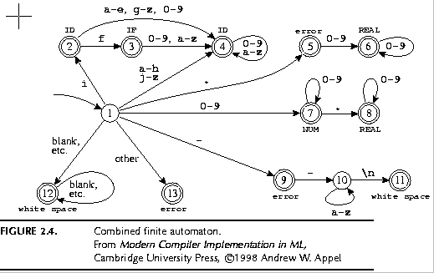
Pathological Example
if { return IF; }
[a-z][a-z0-9]* { return ID; }
[0-9]+ { return NUM; }
[0-9]”.”[0-9]*|[0-9]*”.”[0-9]+ { return REAL; }
(\-\-[a-z]*\n)|(“ “|\n|\t) { ; }
. { error(); }

Slide 25
The Lexical Analysis Problem
Given
A set of token descriptions
Token name
Regular expression
An input string
Partition the strings into tokens (class, value)
Ambiguity resolution
The longest matching token
Between two equal length tokens select the first

Slide 26
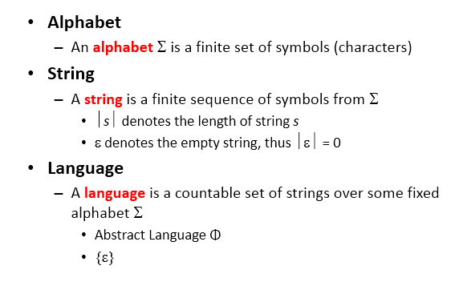
Strings and Languages

Slide 27
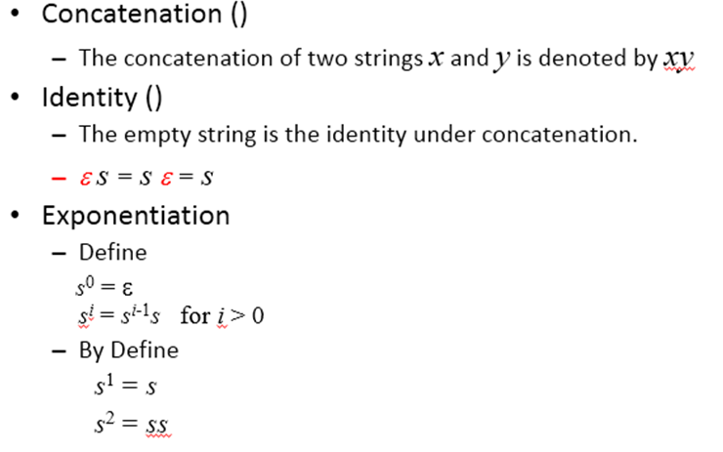
String Operations

Slide 28
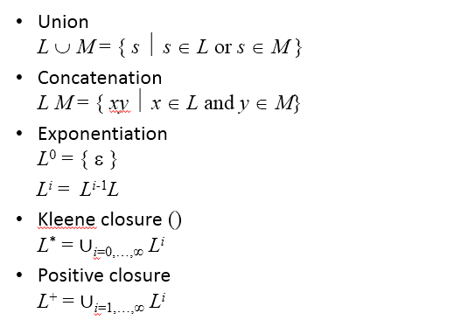
Language Operations

Slide 29
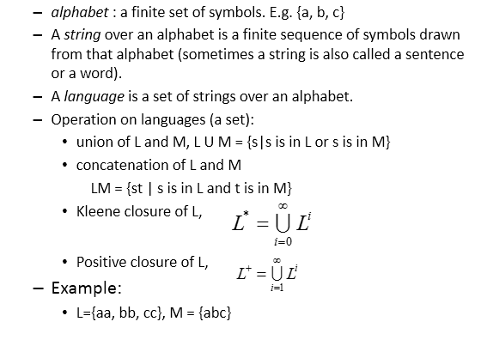

Slide 30
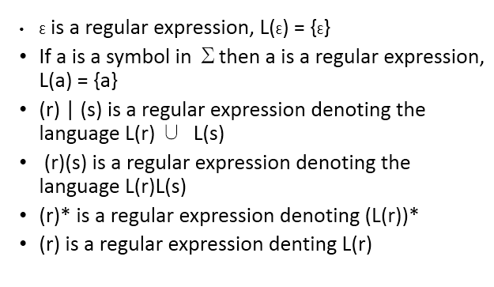
Regular expressions

Slide 31
Regular Expressions
Regular Expressions
A convenient means of specifying certain simple sets of strings.
We use regular expressions to define structures of tokens.
Tokens are built from symbols of a finite vocabulary.
Regular Sets
The sets of strings defined by regular expressions.

Slide 32
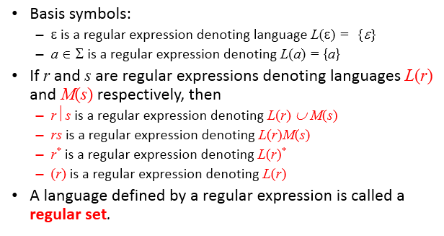
Regular Expressions

Slide 33
Operator Precedence
Operator | Precedence | Associative
* | highest | left
concatenation | Second | left
| | lowest | left

Slide 34
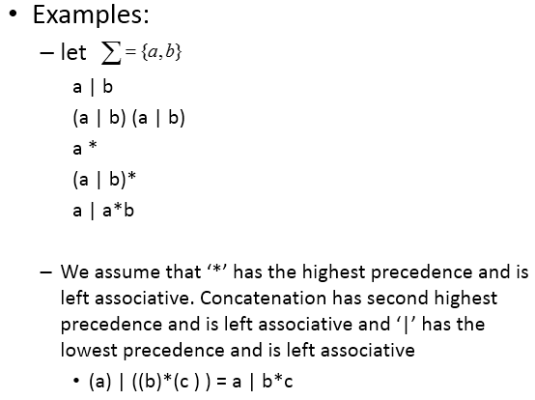

Slide 35
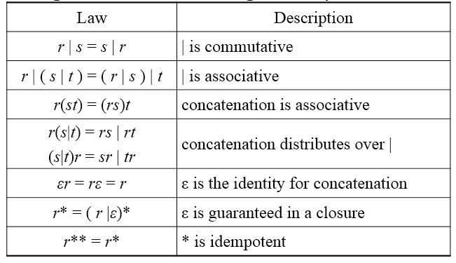
Algebraic Laws for Regular Expressions

Slide 36
Regular definitions
d1 -> r1
d2 -> r2
…
dn -> rn
Example:
letter_ -> A | B | … | Z | a | b | … | Z | _
digit -> 0 | 1 | … | 9
id -> letter_ (letter_ | digit)*

Slide 37
Extensions
One or more instances: (r)+
Zero of one instances: r?
Character classes: [abc]
Example:
letter_ -> [A-Za-z_]
digit -> [0-9]
id -> letter_(letter|digit)*

Slide 38
Lex Regular Expressions
Expression | Matches | Example
\c | Character c literally | \*
“s” | String s literally | “**”
. | Any character but newline | a.*b
^ | Beginning of a line | ^a
$ | End of a line | a$
[^s] | Any one character not in string s | [^a]
r* | Zero or more strings
r? | Zero or one
r{m,n} | Between m and n occurrences of r | a{1,2}
ab | concatenation
r1|r2 | r1 or an r2 | a|b
(r) | Same as r | (a|b)
r1/r2 | r1 when followed by r2 | (i/am)
R+ | One or more strings

Slide 39
Regular Definitions
If Σ is an alphabet of basic symbols, then a regular definitions is a sequence of definitions of the form: d₁ → r₁ d₂ → r₂ … d_{n} → r_{n}
Each d_{i} is a new symbol, not in Σ and not the same as any other of d’s.
Each r_{i} is a regular expression over the alphabet Σ ∪ {d₁, d₂, …, d_{i-1} }
Any d_{j} in r_{i} can be textually substituted in r_{i} to obtain an equivalent set of definitions

Slide 40
Extensions of Regular Definitions
One or more instance
r⁺ = rr* = r*r
r* = r⁺ | ε
Zero or one instance
r? = r |ε
Character classes
[a-z] = a⏐b⏐c⏐…⏐z
[A-Za-z] = A|B|…|Z|a|…|z
Example
digit → [0-9]
num → digit⁺ (. digit⁺)? ( E (+⏐-)? digit⁺ )?

Slide 41
Write character classes for the following sets of characters:
The first ten letters (up to "j") in either upper or lower case.
The lowercase consonants.
The "digits" in a hexadecimal number (choose either upper or lower case for the "digits" above 9).
The characters that can appear at the end of alegitimate English sentence (e.g. , exclamation point) .

Slide 42
Write Regular Expressions for
Arithmetic expression
Relational expression

Slide 43
Most languages are case sensitive, so keywords can be written only one way, and the regular expressions describing their lexeme is very simple. However, some languages, like SQL, are case insensitive, so a keyword can be written either in lowercase or in uppercase, or in any mixture of cases. Thus, the SQL keyword SELECT can also be written select, Select, or sElEcT, for instance. Show how to write a regular expression for a keyword in a case­ insensitive language. Illustrate the idea by writing the expression for "select" in SQL.

Slide 44
Answer
select -> [Ss][Ee][Ll][Ee][Cc][Tt]
OR
Select→(S|s)(E|e)(L|l)(E|e)(C|c)(T|t)

Slide 45
Regular Definitions and Grammars
Context-Free Grammars
stmt → if expr then stmt ⏐ if expr then stmt else stmt ⏐ ε expr → term relop term ⏐ term term → id ⏐ num
ws → ( blank | tab | newline )⁺
Regular Definitions
digit → [0-9]
letter → [A-Za-z]
if → if then → then else → else relop → < ⏐ <= ⏐ <> ⏐ > ⏐ >= ⏐ = id → letter ( letter | digit )* num → digit⁺ (. digit⁺)? ( E (+ | -)? digit⁺ )?

Slide 46
Recognition of tokens
Starting point is the language grammar to understand the tokens:
stmt -> if expr then stmt
| if expr then stmt else stmt
| Ɛ
expr -> term relop term
| term
term -> id
| number

Slide 47
Recognition of tokens (cont.)
The next step is to formalize the patterns:
digit -> [0-9]
Digits -> digit+
number -> digit(.digits)? (E[+-]? Digit)?
letter -> [A-Za-z_]
id -> letter (letter|digit)*
If -> if
Then -> then
Else -> else
Relop -> < | > | <= | >= | = | <>
We also need to handle whitespaces:
ws -> (blank | tab | newline)+

Slide 48
LEXEMES | TOKEN NAME | ATTRIBUTE VALUE
Any ws | - | -
if | if | -
then | then | -
else | else | -
Any id | id | Pointer to table entry
Any number | number | Pointer to table entry
< | relop | LT
<= | relop | LE
= | relop | EQ
<> | relop | NE
> | relop | GT
>= | relop | GE

Slide 49
Transition Graph for FA
is a state
is a transition
is a the start state
is a final state

Slide 50
Transition Diagrams
relop → < ⏐ <= ⏐ <> ⏐ > ⏐ >= ⏐ =
start
<
=
0
1
2
return(relop, LE)
>
3
return(relop, NE)
other
*
4
return(relop, LT)
=
5
return(relop, EQ)
>
=
6
7
return(relop, GE)
other
*
8
return(relop, GT)

Slide 51
Transition Diagrams
id → letter ( letter | digit )*
letter or digit
other
*
start
letter
9
10
11
return (getToken(), installID() )

Slide 52
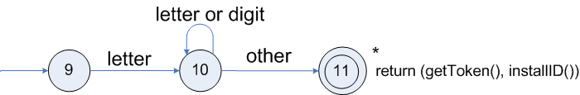
Transition diagrams (cont.)
Transition diagram for reserved words and identifiers

Slide 53
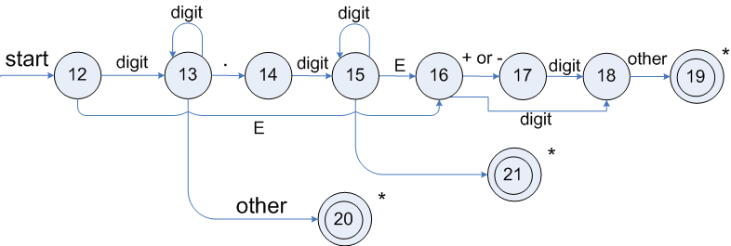
Transition diagrams (cont.)
Transition diagram for unsigned numbers

Slide 54
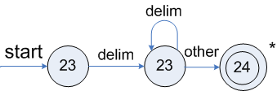
Transition diagrams (cont.)
Transition diagram for whitespace

Slide 55
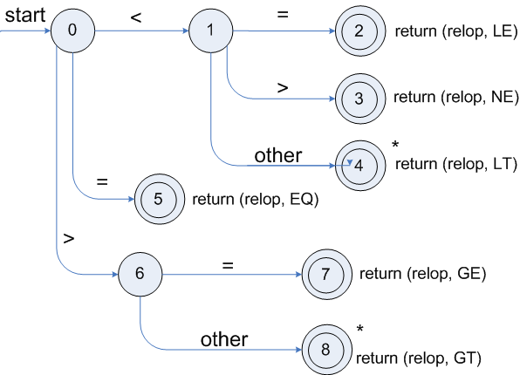
Transition diagrams diagrams (cont.)
Transition diagram for relop

Slide 56
Architecture of a transition-diagram-based lexical analyzer Implement of RELOP
TOKEN getRelop()
{
TOKEN retToken = new(RELOP);
while (1) { /* repeat character processing until a
return or failure occurs */
case 0: c = nextChar();
if (c == ‘<‘) state = 1;
else if (c == ‘=‘) state= 5;
else if (c == ‘>‘) state= 6;
else fail(); /* lexeme is not a relop */
break;
case 1: ...
...
case 8: retract();
retToken.attribute = GT;
return(retTOKEN);
}
}

Slide 57
Lexical Analyzer Generator - Lex
Lex Source program
lex.l
Lexical Compiler
lex.yy.c
C
compiler
lex.yy.c
a.out
a.out
Sequence of tokens
Input stream

